Slide 1
Python Programming
Presented by:
ARAVIND G
JUNIOR SOFTWARE DEVELOPER
2CQR AUTOMATION PRIVATE LIMITED

Slide 2
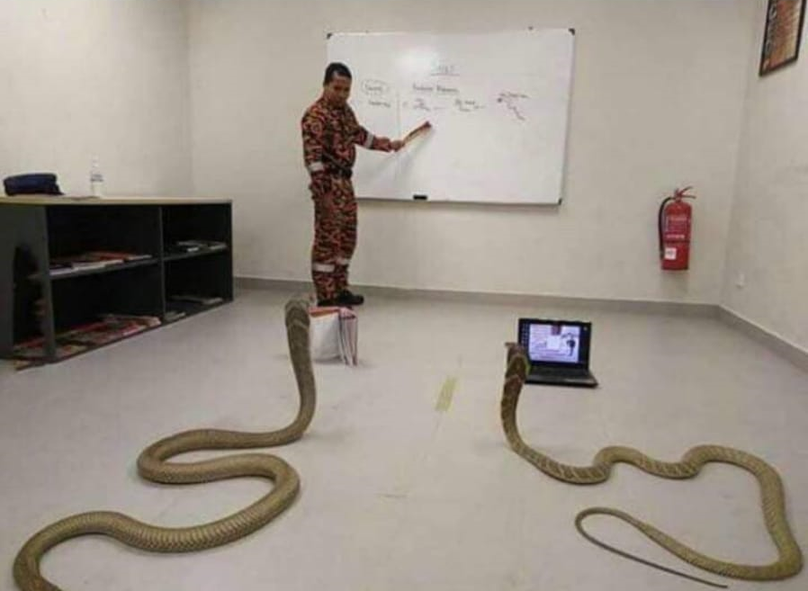
Agenda
Introduction & Basic Data Types
Advanced Data Types
Flow Control
Functions
Objects & Classes
The PyPi Package

Slide 3
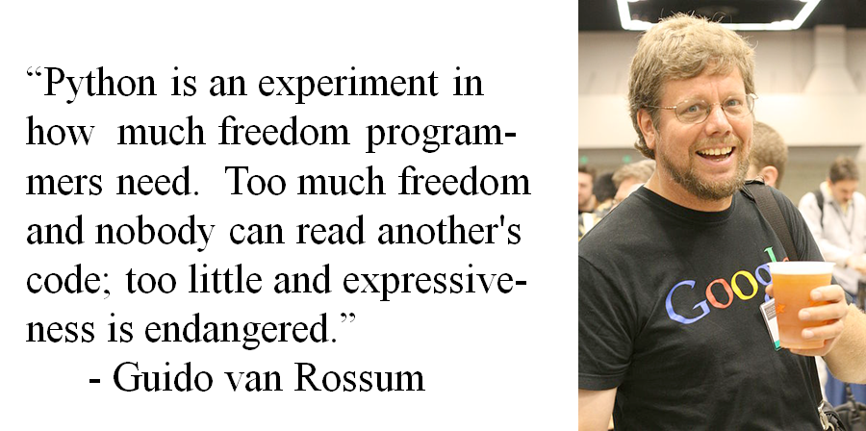
What is Python?

Slide 4
Brief History of Python
Invented in the Netherlands, early 90s by Guido van Rossum
Named after Monty Python
Open sourced from the beginning
Considered a scripting language, but is much more
Scalable, object oriented and functional from the beginning
Used by Google from the beginning
Increasingly popular

Slide 5
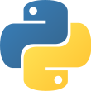
What is Python?
Python is a popular high-level programming language used in various applications
Python is an easy language to learn because of its simple syntax
Python can be used for simple tasks such as plotting or for more complex tasks like machine learning

Slide 6
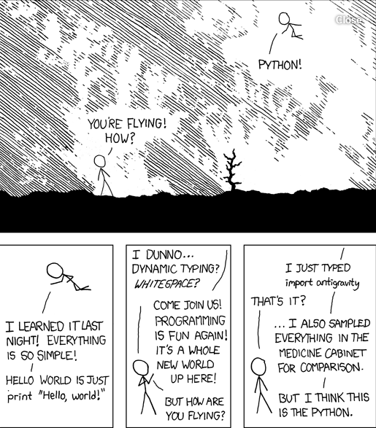
Advantages of Python?
Because Python is an interpretive language, it has a number of advantages:
Automatic memory management.
Expressivity and syntax that is ‘English’.
Ease of programming.
Minimises development time.
Python also has a focus on importing modules, a feature that makes it useful for scientific computing.

Slide 7
Disadvantages
Interpreted languages are slower than compiled languages.
The modules that you import are developed in a decentralised manner; this can cause issues based upon individual assumptions.
Multi-threading is hard in Python

Slide 8
Introduction & Basic Data Types

Slide 9





Python
Powerful general purpose programming language created by Guido Van Rossum in the late 1980s
Use to develop web applications, data science, rapid application development, and so on
Fewer lines of codes for programs than most of other programming languages

Slide 10
Hello World
Let’s write our first python program…
In C
#include <stdio.h>
void main() {
printf("Hello, World!");
}

Slide 11
Variables - Naming
Named location used to store data in the memory
Store numbers, strings (a sequence of characters), or even more complex data types like lists, dictionaries and objects
By convention, lower case separated by underscores 😀
Do not use keywords for variable names. Keywords hold special meaning to the compiler and get misinterpreted
For example, don’t use list, int, dict, str, if, while as variable names

Slide 12
Variables - Types
Way of determining the type of something
Examples are int, float, str, bool and so on
Special type that signifies no value at all known as “None”
>>> x = None
>>> type(x)
<class 'NoneType'>

Slide 13
Numbers
Three different types of numbers
Integer
Float
Complex
Booleans are True or False values stored as numbers under the hood
True is 1 and False is 0

Slide 14
Numbers - Operations
Operations such as addition, subtraction, multiplication, division and modulus can be performed on the numbers
Addition of float and int gives the float as result
Division of two ints gives the result as float
Let’s get back to editor for few examples...

Slide 15
Strings
Can be enclosed with single or double quotes
Can also be concatenated using + operator
Can use \ (backward slash) to use same type of quote in the string
Can use regular, formatted or f-strings while printing strings
Use triple quotes for the multi-line strings

Slide 16
Input, Output and Import
Functions like input() and print() are widely used for standard input and output operations respectively
Modules are highly useful when your program grows bigger
For example,
>>> from math import pi
>>> pi
3.141592653589793

Slide 17
Comments
Extremely useful as it helps to better understand a program
Use the # (hash) symbol to start writing a comment
Another way of doing this is to use triple quotes, either ''' or """
Triple quotes are generally used for multi-line strings. But they can be used as multi-line comment as well

Slide 18
Advanced Datatypes

Slide 19
The Tuple
The tuple is like an Array in C, but it can store values of different data types together
In Python programming, a tuple is created by placing all the items (elements) inside a set of round brackets ( ), separated by commas
Tuples are immutable
tup = ('Ankit', 21) print(tup[0], " is ", tup[1], "years old")

Slide 20
The List
The list is also like an Array in C, and can also store values of different data types together
In Python programming, a list is created by placing all the items (elements) inside a set of square brackets [ ], separated by commas
Tuples are mutable
li = ['Ankit', 21] li[1] = li[1] + 1 print(li[0], " is ", li[1], "years old")

Slide 21
The Set
Python sets are like Math sets, a collection of non repeating entities
In Python programming, a set is created by placing all the items (elements) inside a set of curly brackets { }, separated by commas
The advantage of sets is the availability of operations like union, intersection, difference, symmetric difference etc
>>> fruits = {"Apple", "Pineapple", "Tomato", "Peach"} >>> pizza_toppings = {"Onion", "Tomato", "Pineapple", "Mushroom"} >>> print(fruits.intersection(pizza_toppings)) {‘Tomato’, ‘Pineapple’}

Slide 22
The Dictionary
The dictionary stores key value pairs
In Python programming, a dictionary is created by placing all the pairs inside a set of round brackets { }, separated by commas
They allow values to be accessed using the keys
d = {'Ankit': 21, 'Jay': 20} d['Jay'] = 21 print(d['Ankit'])

Slide 23
Flow Control

Slide 24
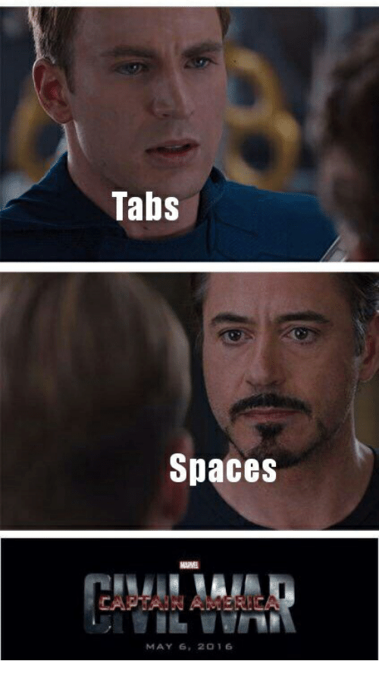
Indentation
Unlike most other programming languages, blocks of code are not surrounded by curly braces in python
Python uses indentation instead, a consistent use of tabs or spaces
Silicon Valley tabs vs. spaces

Slide 25
if...else
Used for decision making
if test expression:
Body of if
if test expression:
Body of if
elif:
Body of elif
else:
Body of else
if test expression:
Body of if
else:
Body of else

Slide 26

Programming using Python
Loops

Slide 27
for loop
Used to iterate over a sequence or other iterable objects
Continues until we reach the last item in the sequence
Body of the for loop is separated using indentation
for val in sequence:
Body of for
>>> names = ['Jay', 'Ankit']
>>> for name in names:
... print("Hello", name)
...
Hello Jay
Hello Ankit

Slide 28
while loop
the major difference between while and for loops is that the while loop continues till the test expression is true
while test_expression:
Body of while
>>> i = 2
>>> while i:
... print("Hello")
... i = i - 1
...
Hello
Hello

Slide 29
break and continue
These are used to alter the flow of a normal loop
break statement terminates the loop containing it
continue statement skips the rest of the code inside a loop for the current iteration only
>>> for i in range(4): ... if i == 3: ... break ... print(i) ... 0 1 2
>>> for i in range(4): ... if i == 2: ... continue ... print(i) ... 0 1 3

Slide 30
List comprehensions
These are used to create a modified list, applying some sort of condition and filter on each element of the list
>>> Numbers = [21, -17, 9] >>> Squares = [num * num for num in Numbers if num > 0] >>> print(Squares) [441, 81]

Slide 31
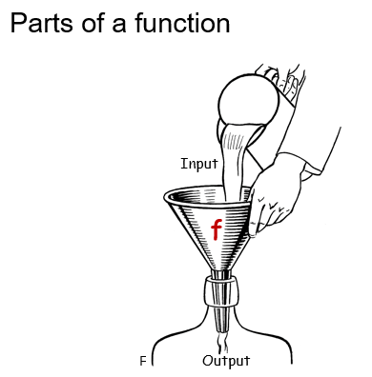
Functions

Slide 32
Functions - Introduction
A function is a block of organized, reusable code that is used to perform a specific action or a task.
Functions help break our program into smaller and modular chunks.
As our program grows larger and larger, functions make it more organized and manageable.
Furthermore, it avoids repetition and makes code reusable. (DRY)

Slide 33
Functions - Syntax and Declaration
def function_name(parameters): """docstring""" statement(s)
In Python, the keyword def indicates the start of a function and the body of a function is indented.
A function_name is mentioned to uniquely identify it.
Parameters (optional) are provided through which we pass values to a function.
An optional return statement is used to return a value from the function.

Slide 34
Functions - Call a function
Once we have defined a function, we can call it from another function, program or even the Python prompt. To call a function we simply type the function name with appropriate arguments for respective parameters.
function_name(arguments)

Slide 35
Functions - Return statement
The return statement is used to exit a function and go back to the place from where it was called.
This statement can contain expression which gets evaluated and the value is returned.
def function_name(parameters): """docstring""" value = statement(s)
return value

Slide 36
Functions - Arguments
Values assigned to the parameters of the functions.
Three types of arguments:
Variable - Provided value gets assigned to parameter.
Default - Default value gets assigned to parameter if the value is not provided.
Arbitrary - Used when we don’t know the number of arguments in advance.

Slide 37
Functions - kwargs
def add(x, y): return x + y
val1 = add(x=2, y=6)
val2 = add(y=6, x=2)
When we call a function with some values, these values get assigned to the arguments according to their position.
Python allows functions to be called using keyword arguments or kwargs. When we call functions in this way, the order (position) of the arguments can be changed.

Slide 38


Functions - Parameters vs. Arguments
Parameter is variable in the declaration of function.
Argument is the actual value of this variable that gets passed to function.

Slide 39
Functions - Scope and Lifetime of variables
Scope of a variable is the portion of a program where the variable is recognized.
Lifetime of a variable is the period throughout which the variable exists in the memory. The lifetime of variables inside a function is as long as the function executes.

Slide 40
Functions - Scope and Lifetime of variables
Global variable - declared outside of the function or in global scope and can be accessed inside or outside of the function.
Local variable - declared inside the function's body or in the local scope.
Nonlocal variable - neither global or local.

Slide 41
Functions - Global keyword
Global variables (outside of the function) are visible from inside the function since they have a global scope.
We can read these values from inside the function but cannot change (write) them.
In order to modify the value of variables outside the function, they must be declared as global variables using the keyword global

Slide 42
Classes and Objects

Slide 43
Introduction to Object Oriented Programming
It defines a set of attributes (variables) and functions that belong to the class
It models real world entities, mapping their attributes and behaviours to class variables and functions
Classes are created as blueprints for objects. They can be seen as a custom datatype, defining what operations and type of data is stored about all its objects
Objects are instances of a class

Slide 44
Class
As blueprints of objects, classes have attributes that are copied into each object of the class, and functions that are available on each object as well
We use @classmethod function decorator to define a function that only gets access to the class’ data
We use @staticmethod function decorator to define a function that gets no access to any data. It is used to run related operations that do not require the data itself

Slide 45
Object
Objects are instances of a class
They have a set of values for the attributes defined in the class
Each class has an __init__ function, that is run each time an object is created
Class Car(): model = None brand = None def __init__(self, b, m): self.model = m self.brand = b my_car = Car("Toyota", "Innova")

Slide 46
The PyPi package

Slide 47
PyPi - An Introduction
The reason python code is so short is that it follows the sentiment of not reinventing the wheel
What a lot of languages require you to code, python provides in built, like searching, sorting, math etc
Yet, there are some things that do not ship with python, but can be installed
Python allows developers to import and use code written by other developers, from the open source repository, Python Package Index (PyPi)

Slide 48
PyPi - pip
pip can be used to install PyPi packages
Python ships with pip natively
Pip has some amazing native functions like install and freeze
It lets you also maintain a requirements file, which is a newline separated list of dependencies of your project
> pip install -r requirements.txt
> pip install django
> pip freeze > requirements.txt

